Slide 1
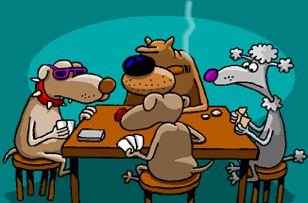
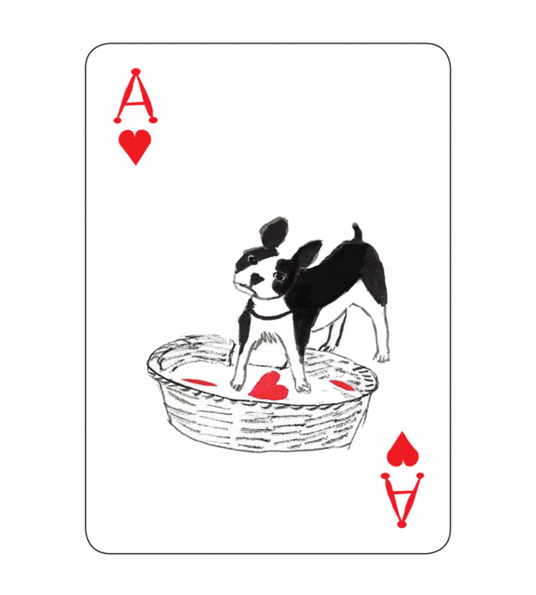
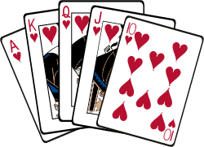
Did they paint a picture last night?
Smoking is harmful to health.

Slide 2
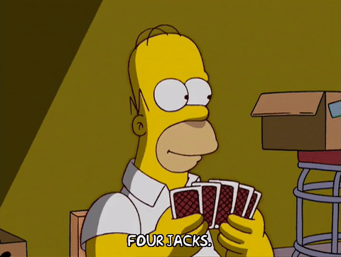
played cards
play cards
〔d〕
動詞後面直接+ed

Slide 3
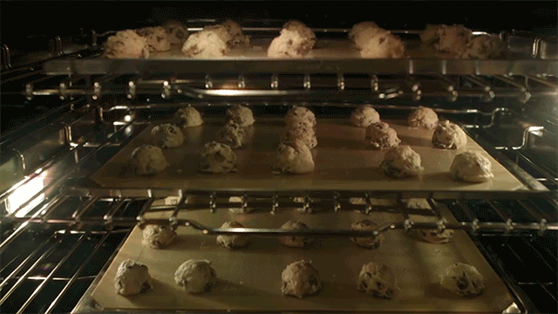
baked cookies
bake cookies
〔t〕
字尾是e直接+d

Slide 4
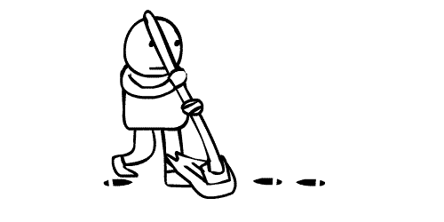
mop the floor
mopped the floor
〔t〕
最後三個字母是子母子排列時，
重覆字尾+ed

Slide 5
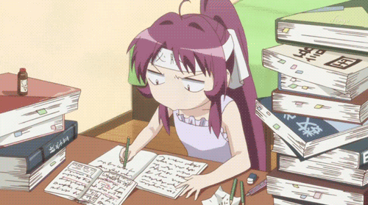
studied
study
〔Id〕
字尾是
子音＋y，
-y + ied

Slide 6
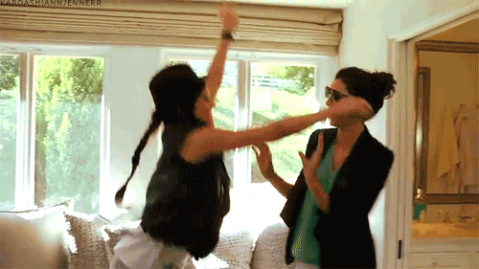
visited my friends
visit my friends
your
his
her
our
their
Mandy’s
〔Id〕
動詞後面直接+ed

Slide 7
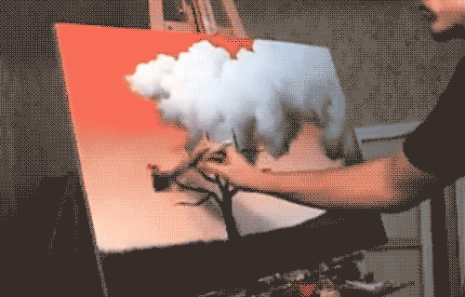
painted a picture
paint a picture
〔 Id 〕
動詞後面直接+ed

Slide 8
played cards
2
3
1
baked cookies
mopped the floor
studied
visited my friends
4
5
6
painted a picture

Slide 10
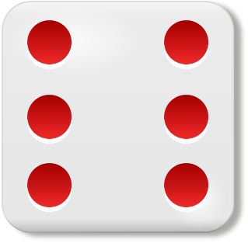
Winner: 同個顏色連成三個一線
Everybody takes turns to throw the dice.
Get a number, choose one picture to read.
Read right, draw one line.
The last person who finishes the blank can put your own color coin on it.
Same color three-in-row→ win!!!

Slide 11
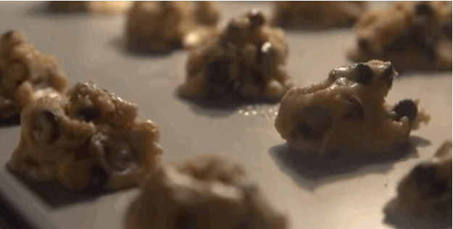
What did you do yesterday?
I baked cookies yesterday.

Slide 12
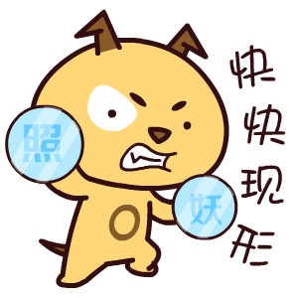
Did you bake cookies yesterday?
過去式助動詞
照妖鏡→ 把動詞打回原形
baked → bake

Slide 13
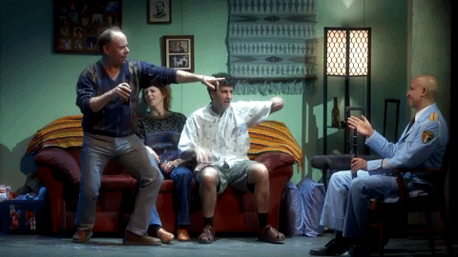
Did he visit his friends last weekend?
Yes, he did. He visited his friends last weekend.

Slide 14
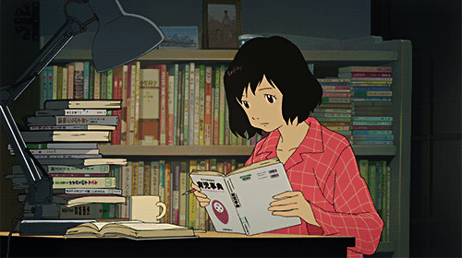
Did she mop the floor last night?
No, she didn’t. She studied last night.

Slide 15
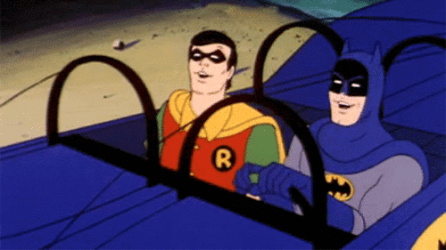
Did they paint a picture last Friday?
No, they didn’t. They listened to music last Friday.

Slide 16
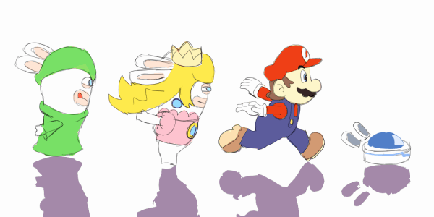

Slide 17
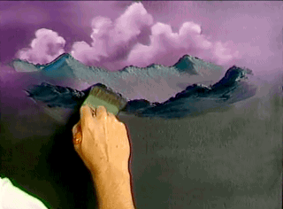
O

Slide 18
Q: Did you paint a picture yesterday?

Slide 19
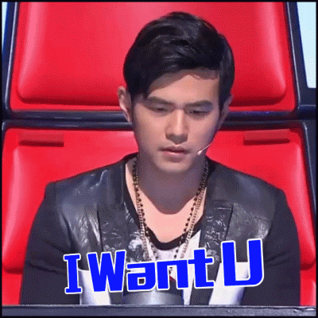
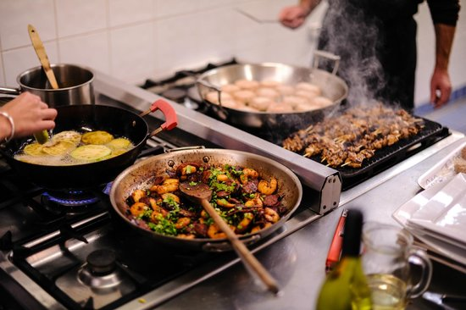
O
X

Slide 20
Q: Did Jay Chou cook dinner yesterday?

Slide 21
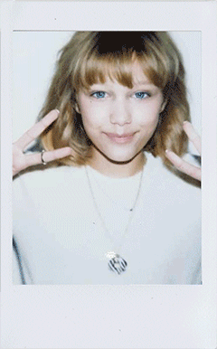
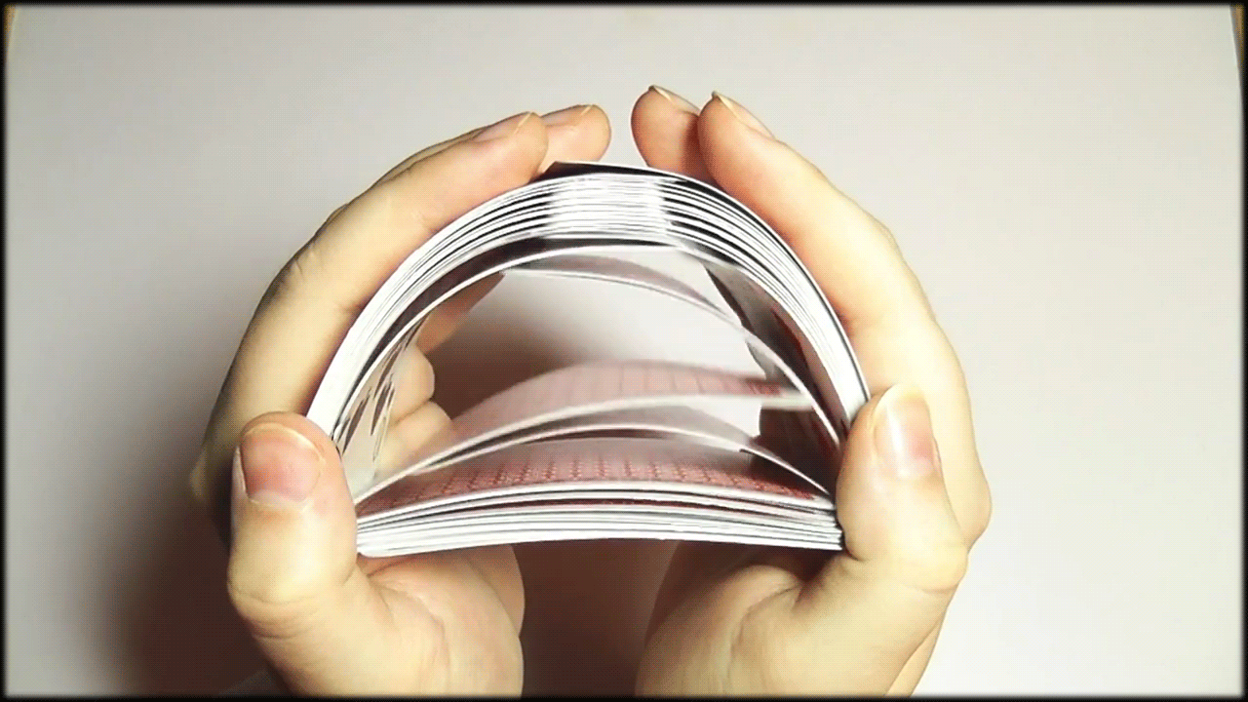
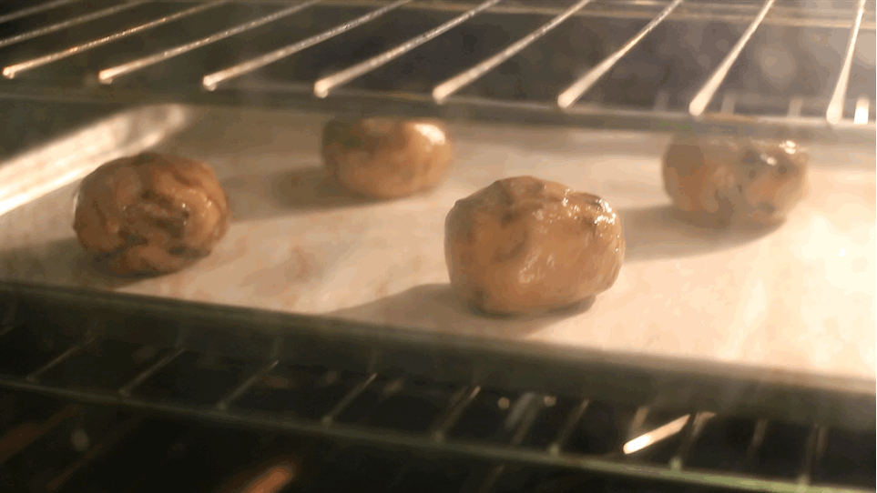
X
X
O

Slide 22
Q: Did Grace Vanderwaal listen to music last night?

Slide 23
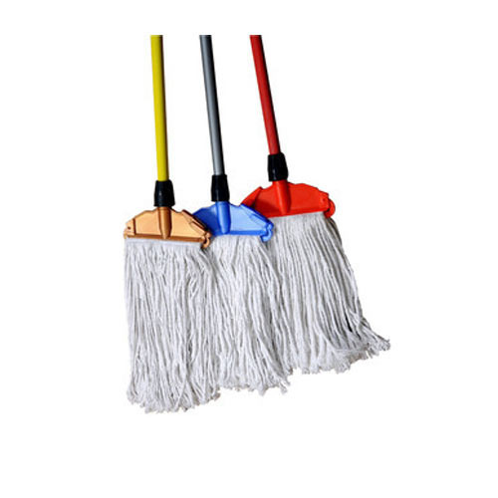
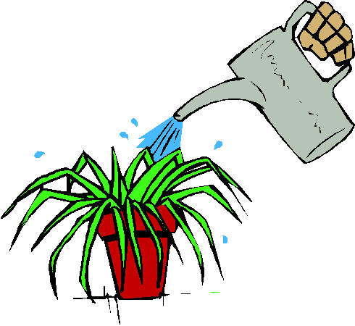
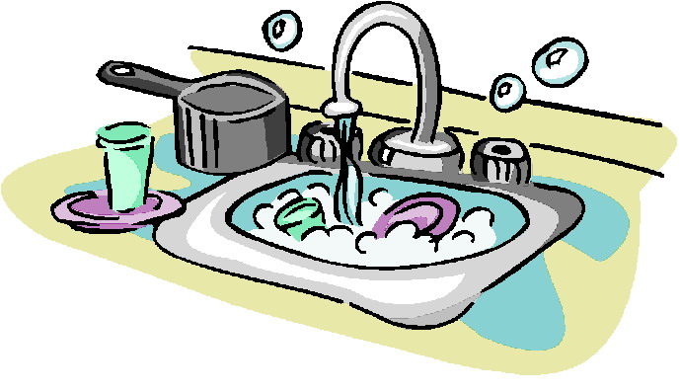
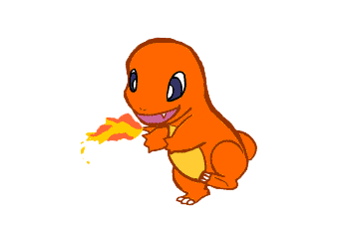
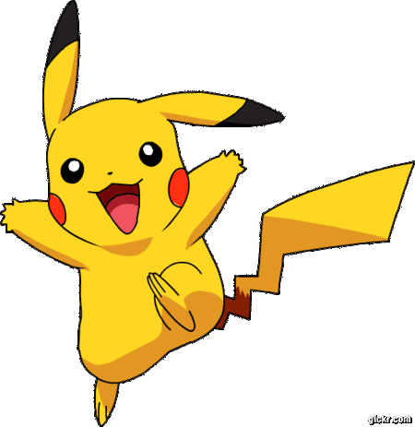
X
O
X
O

Slide 24
Q: Did Pikachu watch TV last weekend?

Slide 25
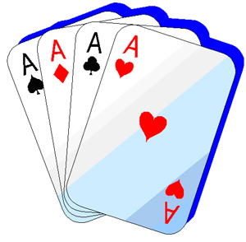
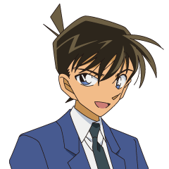
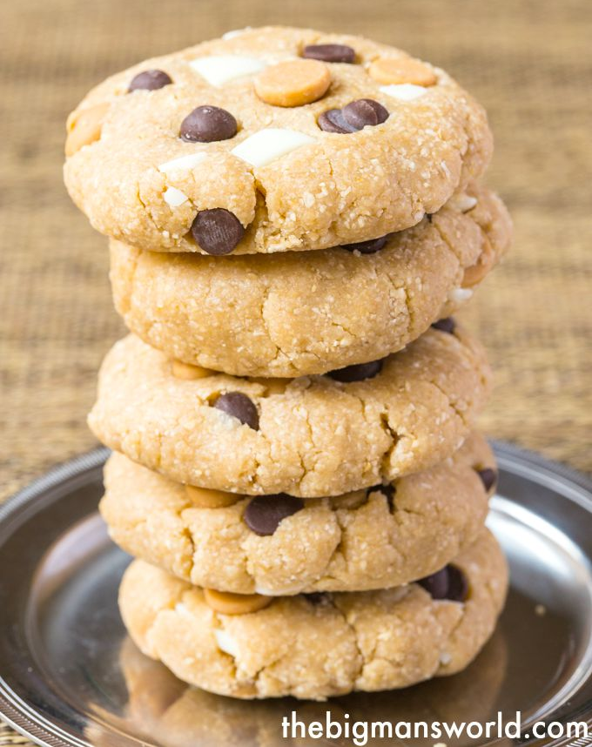
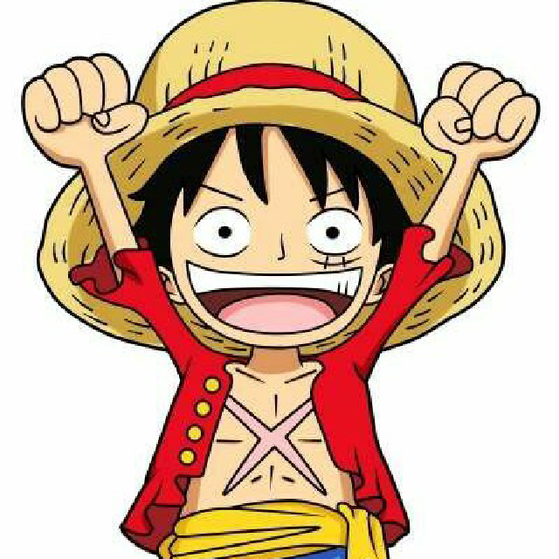
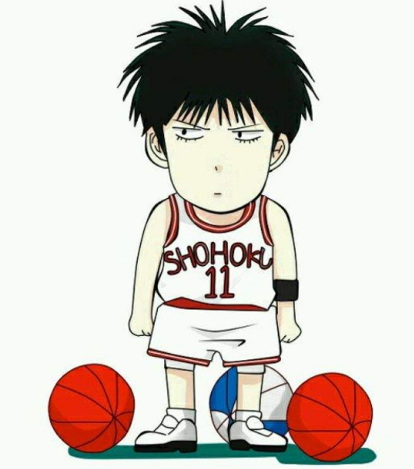
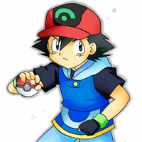
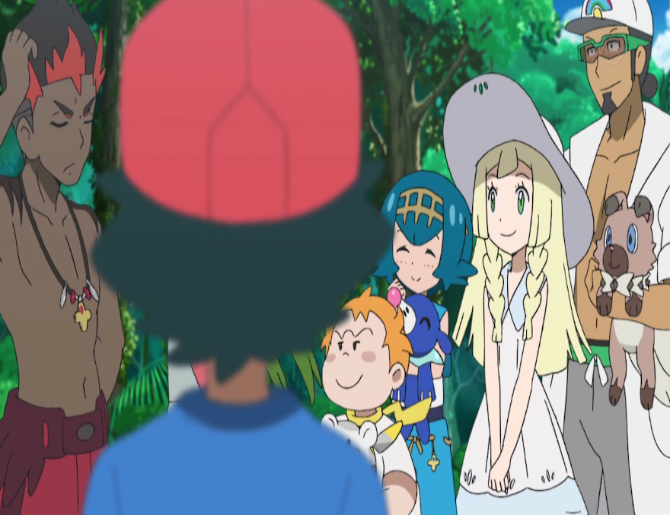
Kudō Shin-ichi
Luffy

Slide 26
Q: Did Luffy visit his friends yesterday morning?

